Slide 1
J.K.A.H.S.M.

Slide 2
Just A KILLER ASTEROID HITTING the SURFACE OF MARS

Slide 3


Slide 4
Introduction
With the advent of technology and the expanding future of space exploration, asteroid mining is becoming more feasible. There are already some components in space, or in the planning stages that will soon be implemented, which will allow asteroid mining to be more cost effective.

Slide 5
Asteroid Composition
Surface Composition Detection using Digital Images
-Samuel Woo

Slide 6
Spectroscopy
The study of observed electromagnetic emissions to deduce chemical composition of the observed material.
Based on the fact that different chemical structures absorb and reflect different wavelengths of light.
By measuring the amount of reflected sunlight from an asteroid at the different wavelengths in the electromagnetic spectrum we can gain information about the chemical composition of the asteroid.
http://www.lpi.usra.edu/books/AsteroidsIII/pdf/3032.pdf
https://en.wikipedia.org/wiki/Emission_spectrum

Slide 7
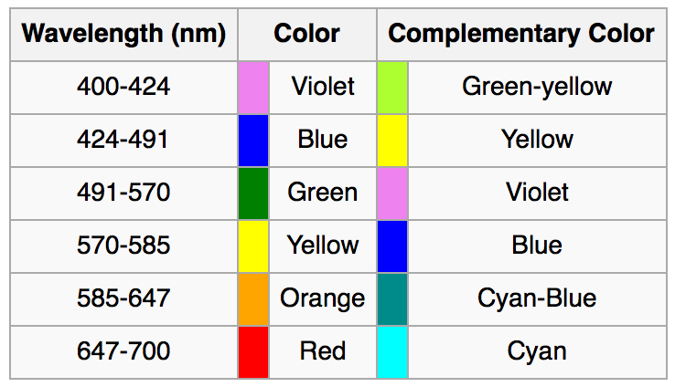

Visible Wavelengths
Human visible light wavelengths range from 380 nm to 760 nm

Slide 8
Asteroid Composition
Meteorites are asteroids that have impacted the earth. They give a clue to possible asteroid composition
Iron meteorites
Iron: 91 percent
Nickel: 8.5 percent
Cobalt: 0.6 percent
Stony meteorites
Oxygen: 36 percent
Iron: 26 percent
Silicon: 18 percent
Magnesium: 14 percent
Aluminum: 1.5 percent
Nickel: 1.4 percent
Calcium: 1.3 percent
http://www.space.com/51-asteroids-formation-discovery-and-exploration.html
https://en.wikipedia.org/wiki/Asteroid#Composition

Slide 9
Problem: Light signals are noisy
Measurements taken by cameras are inherently noisy.
For most images we don’t know how well the camera was calibrated
We don’t know the albedo (ratio of surface reflectance) for the asteroid.
High albedo surfaces will have lots of specular reflection meaning that they will tend to look dark if the reflected light is not at the same angle as the camera lens
We don’t know the albedo of the surface because we don’t know what the surface composition is but we’re trying to use light emissions to estimate surface composition.
Atmosphere of earth also distorts signals by absorbing some of the wavelengths.

Slide 10
Problem: Surface light can be affected by other physical factors
Asteroid surfaces have craters which appear darker
Cratered surfaces also have slightly different surface composition because the impact that produced the crater adds heat and pressure to the surface which changes the chemical composition.
Objects impacting the asteroid surface also deposits foreign materials on the surface.
Space Weathering
Reduces the albedo of the surface by depositing metal nanoparticles on the surface of the asteroid. Produces darker surface over time.
This means fresh craters will have higher albedo and have electromagnetic emissions more likely to reflect the actual composition of the asteroid.
http://www.lpi.usra.edu/books/AsteroidsIII/pdf/3032.pdf
https://news.brown.edu/articles/2012/10/vesta
https://en.wikipedia.org/wiki/Space_weathering

Slide 11

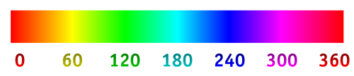
Problem: Recover wavelengths from RGB Space
This is technically impossible since an infinitely many combinations of wavelengths can produce the same perceived color to the human vision system.
RGB is an approximation of real color by adding three primary colors from the red, green, and blue wavelengths.
We can approximate wavelengths from RGB by converting to hue, saturation, and value (HSV) format.
The hue value which ranges from 0 to 360 degrees can be used to estimate wavelength.

Slide 12
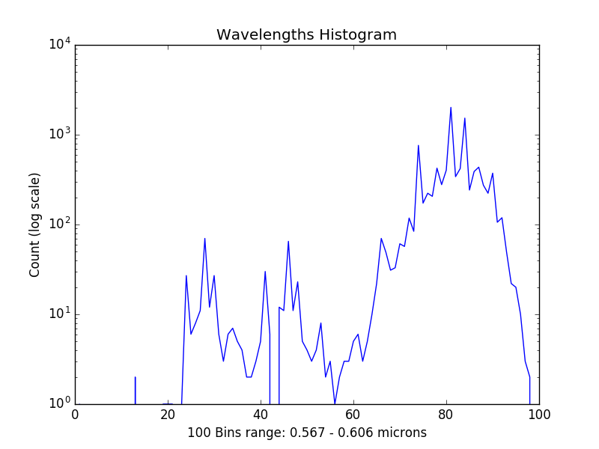
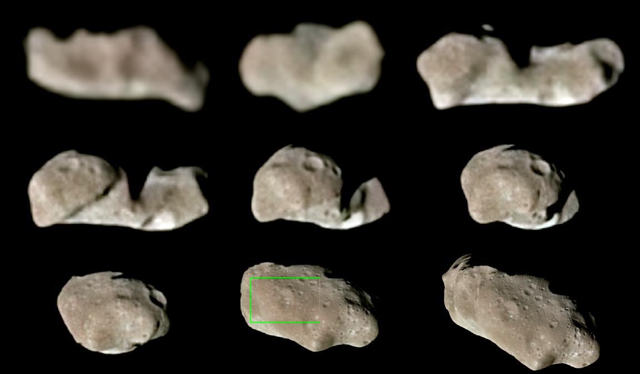

Sample Data:
Patch of sample in green rectangle
$μ=0.599023$
$σ=0.00205689$

Slide 13
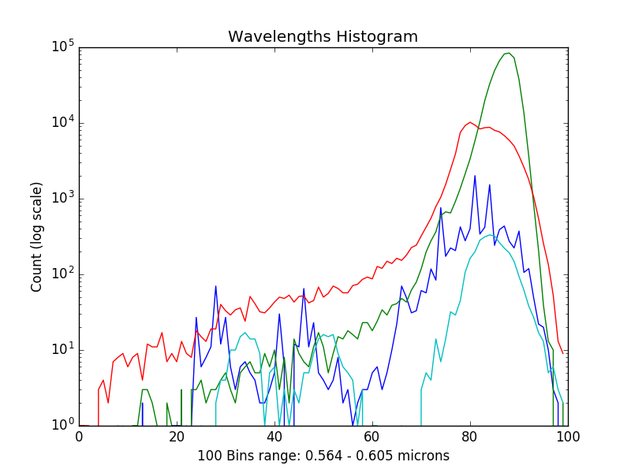
All Wavelength Histograms
Blue: Ida
Green: Olivite
Red: Chondrite
Light blue: Eros

Slide 14
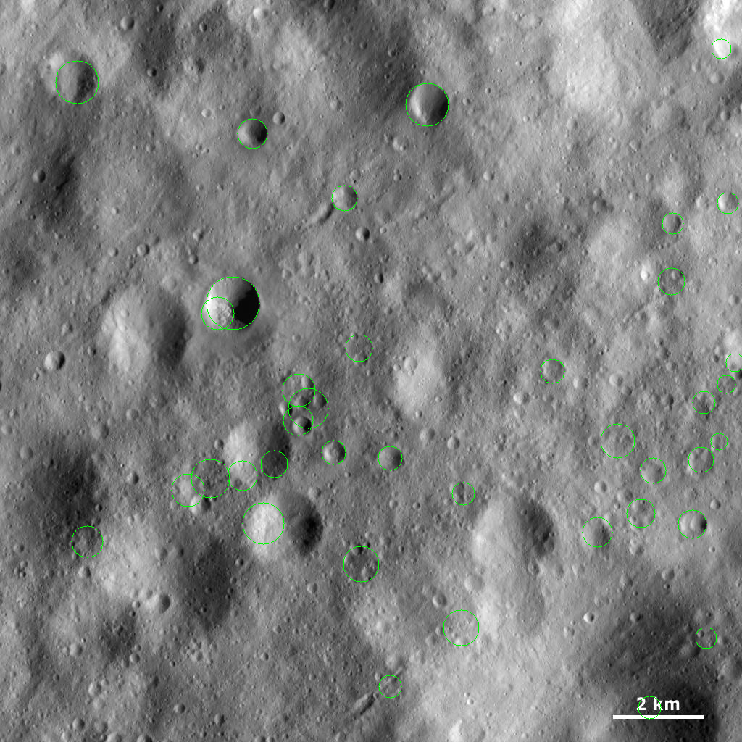
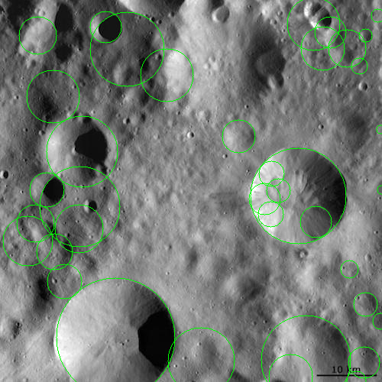
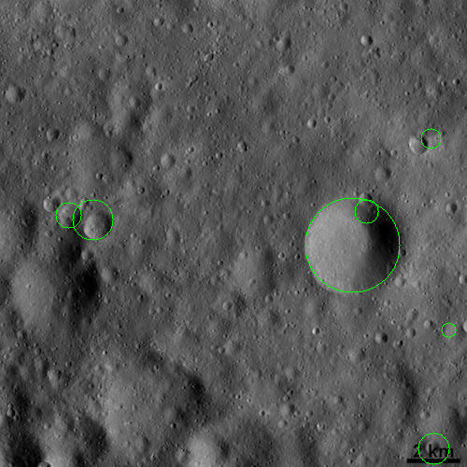
Bonus Feature: Crater Detection
Requires tuning to get good results. Green circles show detected craters.

Slide 15
Asteroid Mining Concept
Houston Russell
Ken Litfin

Slide 16
Manning Mars
Inhabiting Mars is already in the works. A fleet of robotic spacecraft and rovers already are on and around Mars, dramatically increasing our knowledge about the Red Planet and paving the way for future human explorers. The Mars Science Laboratory Curiosity rover measured radiation on the way to Mars and is sending back radiation data from the surface. This data will help us plan how to protect the astronauts who will explore Mars. Future missions like the Mars 2020 rover, seeking signs of past life, also will demonstrate new technologies that could help astronauts survive on Mars. (http://www.nasa.gov/content/nasas-journey-to-mars).
Once Mars is manned, engineers and scientists will send up the necessary equipment and manpower to make a mining base fully functional.

Slide 17
Send in the Drone
Once the determination is made of possible minable elements, our drone will direct the asteroid to Mars for a directed crash landing. Utilizing Mars gives the asteroid stability and flexibility to gather minerals from the asteroid. It will be on the ground, thus allowing for a variety of equipment to be used, as well as an area around it for multiple people to maneuver around.
Calculations will have to be preprogramed into the drone’s computer system before leaving Earth. Scientists and engineers will play a major role in this endeavor since the drone will be unmanned. The calculations will have to be precise.

Slide 18
The drone will come into close proximity of the asteroid. Once in position, the drone will fire a grappling hook into the asteroid’s surface. On the exposed end of the hook will be an ion propulsion unit that will propel the asteroid down to the designated area on Mars.
The drone will have a primary and a secondary shot capability. If, for some reason, there is a failure of the primary harpoon (i.e. the first does not get a secure hold or it shears off), a secondary will be launched to ensure success.

Slide 19
Projectiles would need to be tailor-made for each target. "Some asteroids might have a metallic core, and trying to anchor to them would be like banging a nail into an anvil," says Jeffrey Hoffman, a professor of aeronautics and astronautics at MIT and a former astronaut. "Others may just be a rubble pile, which would be like trying to pitch a tent on a snowfield."
(http://www.popularmechanics.com/space/a6856/how-nasa-will-harpoon-an-asteroid/).
Once the hook is securely anchored in place, the ion propulsion unit will fire, sending it on its way down to Mars.

Slide 20
The Asteroid Has Landed
Once securely on the ground, it’s time for the ground crew to get started. Just like mining on the Moon, it will be the same principle on Mars.

